Slide 1
Learning Fair and Optimal Models From Random Biased Data

Slide 2
Thesis:
If the training distribution contains error such that we do not have access to the unobservable “true” underlying training distribution, then under various modeling assumptions some fairness constraints + Empirical Risk Minimization (ERM) improves accuracy.

Slide 3
Outline
Motivation
Fairness Definitions
Bias Model
Underrepresentation bias
Label bias
Random Classification Noise Model
Interactions of Fairness Definitions with Bias Models

Slide 4

Two Pictures of Scientific Rationality
Since Bacon, it is commonplace to believe that scientific rationality is a means to transform our existing social organization into one more compatible with the demands of justice, liberty or human flourishing.

Slide 5
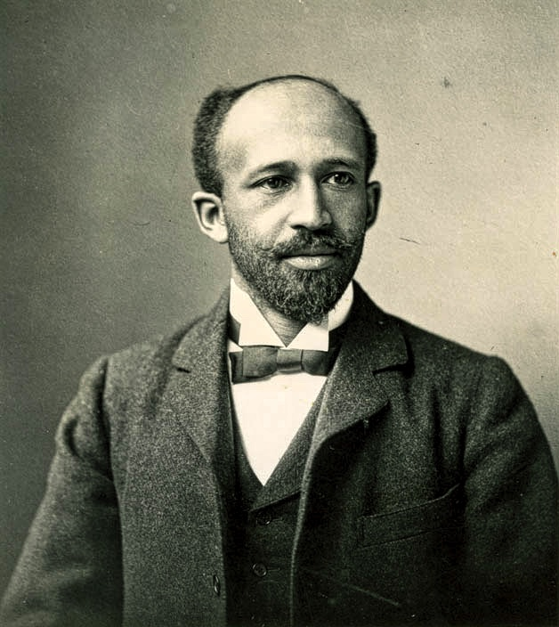
Two Pictures of Scientific Rationality
This picture of scientific rationality arises also from the tradition of African American sociologists who wielded the statistical techniques of their time in the service of social justice.
Early work in this tradition includes Cooper's (1892) A Voice from the South; Crummell's (1883) “A Defense of the Negro Race in America”; Fortune's (1884) Black and White: Land, Labor, and Politics in the South; Ida B. Wells-Barnett's (1895) antilynching work The Red Record (1895); and Dubois’ pioneering (1899) The Philadelphia Negro: A Social Study. Twentieth century landmarks include Work’s (1913) Negro Criminality in the South and the sociological work of Charles Johnson, and Edward Frazier.
Notes:
These were all attempts to counter racist pseudoscience and promote social reform through the expert deployment of statistics. Du Bois, in particular, held that the aim of science was to change the nature and character of society. For Du Bois, scientific inquiry had to explicitly include universal social goals of progress and reform.

Slide 6
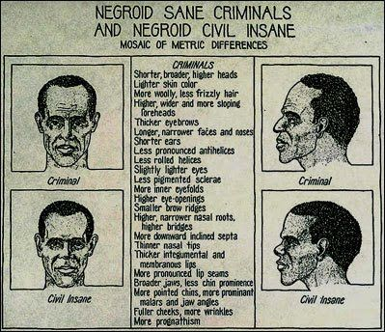
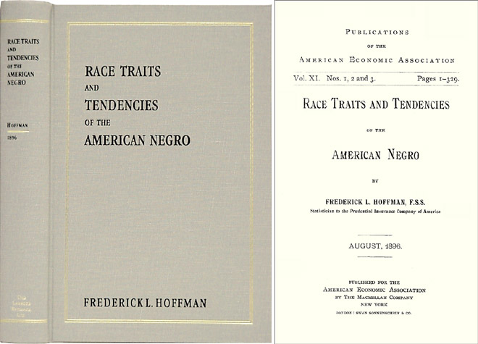
Du Bois on Science
Statistician Frederick L. Hoffman’s work had an influential effect on American discussions of black criminality. Hoffman’s Race Traits and Tendencies of the American Negro (1896) was a pioneering statistical analysis of black health and criminality.
Notes:
Its effect was to shape “racial statistics into a powerful, full-blown narrative of black self-destruction, racial decay, and the futility of reform. From high mortality rates among American blacks, Hoffman concluded that the nation should not waste resources on a “vanishing race.” However, he gave a different interpretation of a high mortality among whites. In their case he blamed society and called for economic intervention. So the high level point is racist societies will inevitably produce many easily-observable correlations between health, criminality and race. In the absence of a methodology for systematically investigating the causes of these associations, unexamined prejudice will fill in the gaps.
In his response to Hoffman, Du Bois makes the same point: “The value of Mr. Hoffman’s work lies in the collection and emphasis of a number of interesting and valuable data in regard to the American Negro.Most of the conclusions drawn from these facts are, however, of doubtful value, on account of the character of the material, the extent of the field, and the unscientific use of the statistical method” (1897, p. 133).

Slide 7
Two Pictures of Scientific Rationality
DuBois, thought democratic social reform was the final (or “mediate”) aim of science: “The object of these studies is primarily scientific – a careful search for truth conducted as thoroughly, broadly, and honestly as the material resources and mental equipment at command will allow; but this is not our sole object; we wish not only to make the Truth clear but to present it in such shape as will encourage and help social reform” (Du Bois, Dusk to Dawn, 1940)

Slide 8

What is Fairness in Machine Learning?
Generally a feature of a model.
Multiple types of fairness definitions.
Notes:
So, so first of all, what do I mean by fairness and machine learning? So fairness in machine learning typically is a property of a model. In other words, we want to have learning algorithms that output models, whether they be neural networks or linear classifier, or something else. That meet some technical definition of fairness. So in other words, fairness is going to be a property of the not so much of the machine learning algorithm itself like the training algorithm. But the output of that algorithm. So the kind of framework in mind is where data comes in and we use the data to train a model. Then we output the model.
No regret learning, for instance, we were really looking more to sequential decision making model like each day we see an x, we have to predict the value of y and then we find out whether we were right or wrong. So in those kinds of settings we might actually talk about the algorithm itself being fair and since the value is not really output of a model. It's just making a series of decisions. And we want might want that series of decisions to be fair, and this is also true in areas like reinforcement learning and also multi arm abandoned problems.
In probability theory, the multi-armed bandit problem (sometimes called the K- or N-armed bandit problem) is a problem in which a fixed limited set of resources must be allocated between competing (alternative) choices in a way that maximizes their expected gain, when each choice's properties are only partially known at the time of allocation, and may become better understood as time passes or by allocating resources to the choice

Slide 9
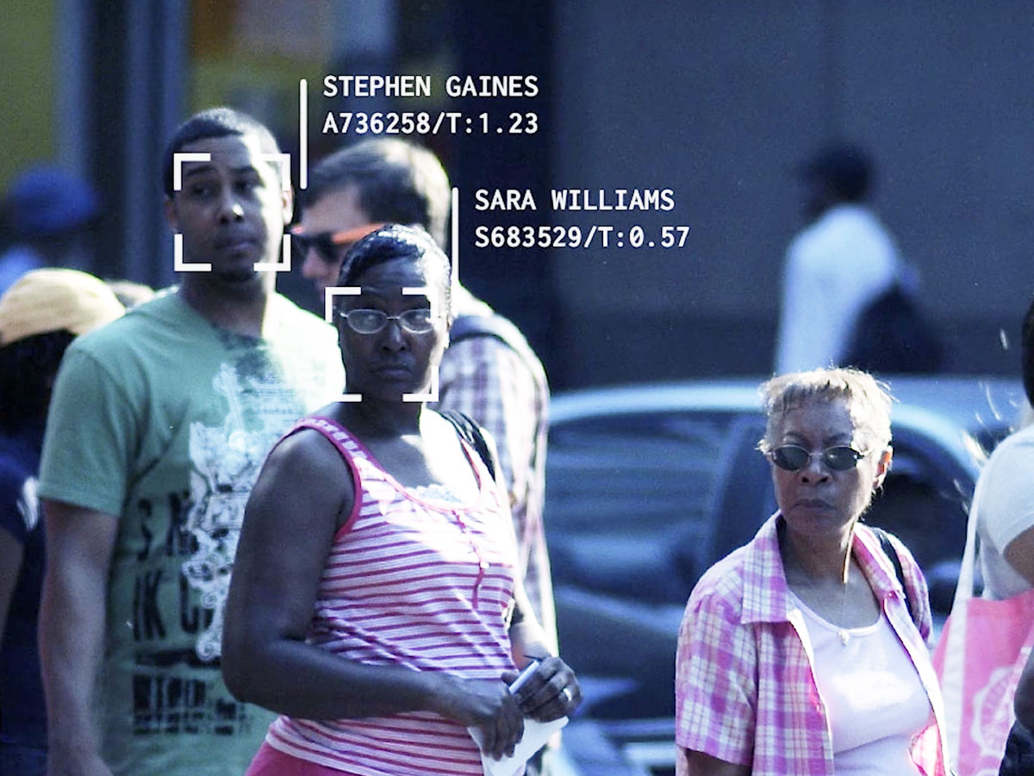
General Models of Fairness in Machine Learning
Group Fairness
Individual Fairness
Interpolations
Notes:
So let’s say I'm a company and I'm building, you know, face recognition technology. And so I'm going to train my face recognition model on many, many images of human faces. And We might want. For instance, the accuracy of my face recognition algorithm to not just be as good as possible overall, but I might want it to work almost equally well on all different racial groups.
So I might want to avoid the problem that many commercial based recognition systems have actually been demonstrated to have Where they do, for instance, make considerably less accurate predictions on black women than they do on white men. So in that type of definition right i'm not promising that to any particular individual, that the system is going to work correctly. It's going to make mistakes, but I might want those mistakes to be evenly distributed across groups. Okay. So this is what I mean at a high level by a group fairness definition.
In contrast, I could ask for fairness definitions that actually make promises to individuals. That somehow I'll promise you that my face recognition algorithm or my, credit scoring model is going to treat you specifically and every other individual in a population in an equitable or fair way, in some sense, okay.
Individual fairness notions are much more difficult to achieve experimentally because of these stronger conditions. Interpolation sits at the space in b/w group and individual and is a fertile area for current research is to try to find things that push group fairness towards individual fairness, but are still practical in some in some experimental sense.

Slide 10
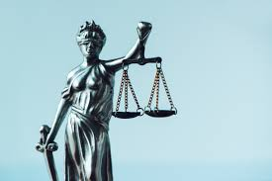
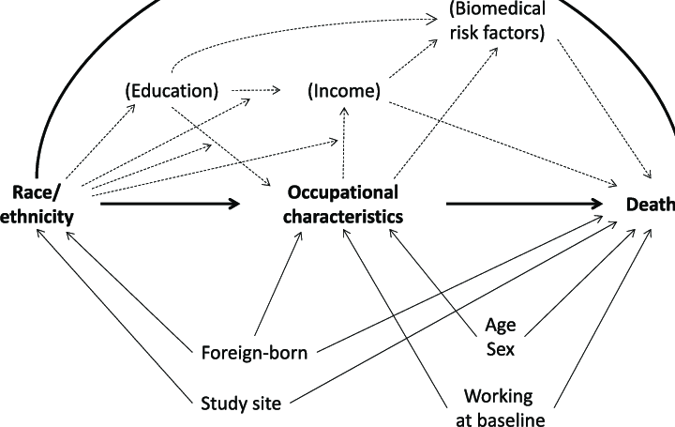
Group Fairness
Start by identifying:
Groups or attributes we wish to “protect” (e.g. race, gender);
What constitutes a harm (e.g. error: false negative/positive).
Then seek to equalize harm rates of harm across groups. Note: fairness notions somewhat subjective and highly domain-specific.
Notes:
So what does your typical group fairness definition look like well, if you want to create a definition of fairness or an instance of a definition of fairness of the group variety there's a couple things you need to do...we, as the designer of the fairness definition need to commit in advance. We need to commit to what group or groups we want to protect for what attributes like race or gender that want to apply our fairness definition to. Further also need to say what constitutes harm. In other words, what, what is the type of decision or mistake that we might make on an individual that would constitute a harm to that individual. We have to sit down and think, like, Okay, in this particular application domain, who are we worried about being harmed and what constitutes harm and we need to kind of specify and commit to those things in advance to craft our fairness definition. But once we have decided what groups or attributes we want to be fair, with respect to and what constitutes harm your typical group fairness definition then seeks to equalize or approximately equalize rates of harm across groups. .

Slide 11
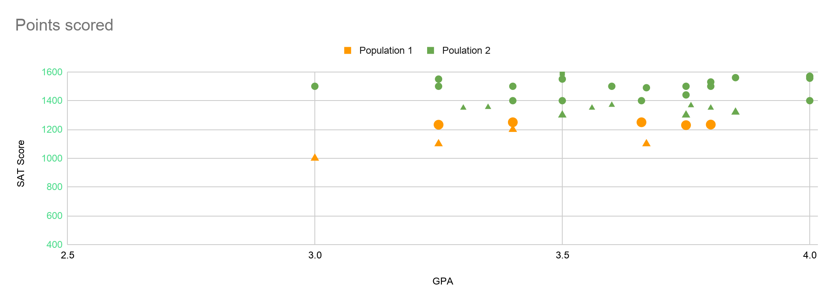
Admissions Example
Notes:
Example from Kearns….Consider a simple two dimensional version of admissions problem where you want to predict educational success. Suppose we have historical data from high school applicants that includes the high school GPA as well as SAT score. Further suppose because these are students who actually attended Penn we know whether they succeeded at Penn or not. By success we can use any kind of quantifiable objectively measurable definition but for the sake of this example let's say concretely an undergrad succeeds at Penn if they graduate within five years of arriving and maintain at least say a 3.0 GPA, but it could be anything you want, as long as we can measure it.
This data consists of green points that are either circles or triangles. The circles and triangles here indicate whether that students succeeded under whatever definition, we are applying. You can kind of see that the cloud of points, has the expected structure. In general, the points up into the right, the people with higher GPA is and SAT scores. Even if we didn't know anything about machine learning and we were asked to use this historical data to build a good predictive model for future admissions decisions we might well pick this simple linear classifier and predict that anything above this blue line is a circle and anything below it is a minus.
There is one false rejection in this model but overall it's pretty good.

Slide 12
Admissions Example
Notes:
Example from Kearns….Consider a simple two dimensional version of admissions problem where you want to predict educational success. Suppose we have historical data from high school applicants that includes the high school GPA as well as SAT score. Further suppose because these are students who actually attended Penn we know whether they succeeded at Penn or not. By success we can use any kind of quantifiable objectively measurable definition but for the sake of this example let's say concretely an undergrad succeeds at Penn if they graduate within five years of arriving and maintain at least say a 3.0 GPA, but it could be anything you want, as long as we can measure it.
This data consists of green points that are either circles or triangles. The circles and triangles here indicate whether that students succeeded under whatever definition, we are applying. You can kind of see that the cloud of points, has the expected structure. In general, the points up into the right, the people with higher GPA is and SAT scores. Even if we didn't know anything about machine learning and we were asked to use this historical data to build a good predictive model for future admissions decisions we might well pick this simple linear classifier and predict that anything above this blue line is a circle and anything below it is a minus.
There is one false rejection in this model but overall it's pretty good.

Slide 13
Admissions Example
Notes:
I would choose like this purple classifier which does a perfect job of separating circles from the triangles. And now you can see what the problem with standard machine learning is.

Slide 14
Admissions Example
Notes:
I would choose like this purple classifier which does a perfect job of separating circles from the triangles. And now you can see what the problem with standard machine learning is.

Slide 15
Admissions Example
Notes:
If I now look at the combine data set and I solve this problem the usual machine learning problem of, let's say, pick the linear classifier which minimizes the overall error on the data set. I will end up choosing the exact same model that I chose on the green population alone.
If I tried to shift this blue classifier down far enough to pick up these additional, orange points I would also pick up so many more green minuses along the way and would increase my overall error significantly. So you can see if I just use the standard minimize the error principle of machine learning I will end up with a model that that that we can say is quantitatively unfair in the specific technical way we've been discussing. Meaning the false rejection rates of this blue classifier on the green population is close to zero but the false rejection rate of that classifier on the orange population is close to 100% So the difference or disparity in the false rejection rates in the two populations is as high as you can get.

Slide 16
Admissions Example
Notes:
Now you might say, well, this is stupid because I know what the group membership is why don't I just apply a two part model? So I've won on both accuracy and fairness.
But consider model if this was a consumer lending application and consider if green and orange are racial groups. Then this strategy would be is against the law in United States. We can now wee how nuanced fairness can get because I'm sure that regulators when they came up with this law must have thought that they are somehow protecting minority groups by enacting a law that forbids the use of race in lending decisions. But in this example forbidding the use of race actually guarantees harm to the very group that you thought you were protecting by such a regulation. The high level solution that the literature proposes is we should change our our training criteria. As I've already suggested I should somehow change our training criteria from only mentioning overall accuracy, which, gives us this unfair model to somehow incorporating an explicit concern with let's say equalizing the false rejection rate across different groups as well. Understanding fairness and the elimination of bias this way is what I want to call predictive invariance and this actually appears in psychometric literature from the 60s
So if I simply take that X, Y data and use it as a sample to train them machine learning model, you know what am I really predicting there. I'm predicting you know collegiate success for the sub population of of applicants to penn who were admitted and who attended pen. Okay, it is not the same as the distribution of applicants to penn period, it is filtered twice right because first we're filtering by the admitted students and then we're filtering by the ones who actually came okay so. And in particular here's something that can go wrong with that right which is.Suppose we look at that historical data and we say oh wow you know. You know this minority population really underperforms that pen right, you know we we look at these X, Y pairs that we have and we look and there's some particular minority group. And their success rate in this data set is much lower than this, the overall success rate in the dataset okay. So we might we might be encouraged to think that, like this pop this subpopulation this minority population of applicants is just like less well qualified for success in pen okay. But then what if I told you well you know what the problem is, is that the pen admissions officers, you know they know certain high schools really well. there's a certain demographic of students who generally apply to him, like it's not an arbitrary sample from the population of the world, obviously. And so it shouldn't surprise anyone if the pen admissions office collectively. s better on average at kind of picking successful students from the high schools that they understand and know better than the ones that they're less familiar with okay.
So, in other words the fact that this minority group succeeded less frequently at penn and the overall population.
could have nothing to do with that minority population being less qualified, in reality, it could just be that the pen admissions office is less good at picking the good students from those high school So my point is, is that you know when there are these filtering steps liking it admissions process and you're only looking at the data that made it through that filtering process. Then a big part of what you're modeling when you fit a model to X, Y data. it's some some you know unknown mixture of actually predicting like the quality of the applicants themselves and predicting the quality modeling the quality of the filtering step in the form of the admissions office okay. And, and so you know, one should be very aware of that in you know building predictive models from college admissions and you know. Some sometimes maybe all you want to do is replicate the human process right, you know, maybe you have to screen, you know. Maybe at a company like Amazon you're getting so many applications for jobs that you, you know you need automated hell. And you don't even have like the pretense that you're going to try to improve on like the vetting process of resumes of the HR department you just like to replicate it like you'd be just happy if you could automate it so that you could you know kind of basically handle more workflow.

Slide 17
Fairness and Bias: Shift in Framework
Usually in ML we think of trade offs b/w fairness and accuracy.
Notes:
Normally if you are doing an optimization and you add some constraint on it. It typically is only going to make your optimization worse. But if you are optimizing the wrong thing then maybe the constraints could make the solution better.
Mention my interests in MI and PI
Aaron mentioned this paper by his advisor.
Michael RCN

Slide 18
Fairness and Bias: Shift in Framework
What if the the training data is biased?
What if we want to formally model something like the effect various forms of racial discrimination on training data?
It turns out if are our learning goal is only accuracy NOT on the data WE SEE but rather on the data we do not see (the unobservable space), then it turns out the solution to this problem is having an explicit concern for fairness.
Notes:
Normally if you are doing an optimization and you add some constraint on it. It typically is only going to make your optimization worse. But if you are optimizing the wrong thing then maybe the constraints could make the solution better.
Mention my interests in MI and PI
Aaron mentioned this paper by his advisor.
Michael RCN

Slide 19
Fairness and Bias: Shift in Framework
Will mathematically model various highly simplified “discmrination” and “bias” settings and then examine will fairness definitions improve accuracy on the TRUE UNSEEN data distribution.
Will then allow for more natural relaxations of various simplifying assumptions.
Notes:
Normally if you are doing an optimization and you add some constraint on it. It typically is only going to make your optimization worse. But if you are optimizing the wrong thing then maybe the constraints could make the solution better.
Mention my interests in MI and PI
Aaron mentioned this paper by his advisor.
Michael RCN

Slide 20
Motivations
Algorithms are increasingly being used aumoate and advise decisions that impact people.
Granted a loan
College Admission
Hired for a Job
Bail and Parole Decisions
It would be a big problem if these are Algorithms are systematically biased against some racial/ethnic/or gender groups
Notes:
Normally if you are doing an optimization and you add some constraint on it. It typically is only going to make your optimization worse. But if you are optimizing the wrong thing then maybe the constraints could make the solution better.
So history of this research from Propublica article that claimed there was demographic disparities with Compas with was an actuarian risk assessment tool used to decided criminal sanctions like wheather you should be released on bail...claims in article are debated and intepreations….One response was to say we need to do ML but we train models we are doing optimization where we have some objective function maybe some surrogate lose and we want to add some constraint to the opotmzation that balances across demographic groups. They are suppose to capture so part of equity or justice. That can be put into your opitmatization problem.

Slide 21
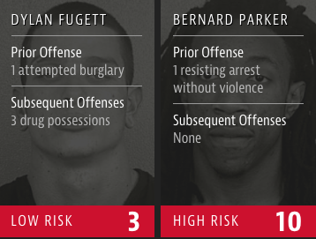
Motivating Example: COMPAS
COMPAS software for predicting recidivism used to aid in bail, parole decisions: classifies candidates as “low risk” or “high risk”.
This study by [Larson-Mattu-Kirchner-Angwin] (ProPublica):
Black defendants who did not recidivate over a two year period were nearly twice as likely to have been classified as high risk compared to their white counterparts (45% vs 23%).
White defendants who reoffended within the next two years were labeled low risk almost twice as often as black re-offenders (48% vs 28%).
Notes:
Pro Publica, Inc., is a nonprofit organization based in New York City. It is a newsroom that aims to produce investigative journalism in the public interest.
So history of this research from Propublica article that claimed there was demographic disparities with Compas with was an actuarial risk assessment tool used to decide criminal sanctions like whether you should be released on bail...claims in article are debated and interpretations….One response was to say we need to do ML but we train models we are doing optimization where we have some objective function maybe some surrogate lose and we want to add some constraint to the optimization that balances across demographic groups. They are suppose to capture so part of equity or justice. That can be put into your optimization problem.

Slide 22
Motivating Example: COMPAS
What this is saying is the false negative rate that is the fraction of “true” positive rates that were predicted as negative was much higher for Black defenands than White defendants.
Also the false positive rate that is fraction of negatives that were predicted as positive was much higher for White defendants than it was for Black defendants.
Notes:
Pro Publica, Inc., is a nonprofit organization based in New York City. It is a newsroom that aims to produce investigative journalism in the public interest.
So history of this research from Propublica article that claimed there was demographic disparities with Compas with was an actuarial risk assessment tool used to decide criminal sanctions like whether you should be released on bail...claims in article are debated and interpretations….One response was to say we need to do ML but we train models we are doing optimization where we have some objective function maybe some surrogate lose and we want to add some constraint to the optimization that balances across demographic groups. They are suppose to capture so part of equity or justice. That can be put into your optimization problem.

Slide 23
Motivating Example: COMPAS
Study by [Flores-Bechtel-Lowenkamp] (Federal Probation Journal): COMPAS is calibrated. Meaning those it calls high risk, it’s about 75% rearrest rate across groups. Of those it calls low risk, it’s about 30% rearrest across groups.
So the meaning in some sense of high risk and low is the same across groups.
Notes:
This motivated fairness in ML and mathematical definitions that can be analyzed.

Slide 24
Motivating Example: COMPAS
Formally the Pr(true|prediction) is similar across groups but Pr(prediction| true) are not the same the across groups.
These two quantities are connected via Bayes Rule which contains a denominator in it called the Base rate.
Because the base rates are different for the two groups it’s not possible to make both Pr(true|prediction) and Pr(true|prediction) be similar.
Notes:
This motivated fairness in ML and mathematical definitions that can be analyzed.

Slide 25
Defining Terms
Score (S): an algorithmic score used to make some consequential decision e.g. a score on a standardized test, or a COMPAS risk score.
Sensitive variable (R): a demographic variable relevant to fairness e.g. race, gender.
Observed outcome (O): contextually relevant future outcome e.g. graduate in five years, or re-arrest within 5 years of release.

Slide 26
Formal Set Up For Label Prediction Task
Domain set – an arbitrary set X. This is the set of objects that we wish to label. Usually, these domain points will be represented by a vector of features (like the race and prior offense). We also refer to domain points as instances and to X as instance space.
Label set: For our current discussion, we will restrict the label set to be a two-element set, usually {0,1} or {−1,+1}. Let Y denote our set of possible labels.

Slide 27
Formal Set Up For Label Prediction Task
Training data: S=((x₁,y₁)...(x_{m},y_{m}))is a finite sequence of pairs in X ×Y: that is, a sequence of labeled domain points.
This is the input that the learner has access to (like a set of people of recidivate). Such labeled examples are often called training examples. We sometimes also refer to S as a training set.

Slide 28
Formal Set Up For Label Prediction Task
The learner’s output: The learner is requested to output a prediction rule, h : X → Y. This function is also called a predictor, a hypothesis, or a classifier.
The predictor can be used to predict the label of new domain points.
In our recidivism example, it is a rule that our learner will employ to predict whether future people the learner examines in going to have a high risk score or not.

Slide 29
Formal Set Up For Label Prediction Task
The i.i.d. assumption: The examples in the training set are independently and identically distributed (i.i.d.) according to the distribution D. That is, every xi in S is freshly sampled according to D and then labeled according to the labeling function.

Slide 30
Popular Fairness Criteria in ML
Independence S⊥R:
“Demographic Parity” [Dwork et al. 2011]:
Predictor satisfies demographic parity wrt groups G if Pr (Pred +) is approximately same across groups.
Example: admit the same fraction of applicants across groups.
Independence has many equivalent terms or variants, referred to as demographic parity, statistical parity, group fairness, disparate impact and others.

Slide 31
Popular Fairness Criteria in ML
Separation: S⊥R∣O
“Equal Opportunity” [Hart-Price-Srebro]
Predictor satisfies “Equal Opportunity” wrt to set of groups G if Pr(predict +|true +) are approximate across groups.
Example: If I would be a good student I should have the same chance of being admitted regardless of my group.
“Equalized Odds” [Hart-Price-Srebro]
Predictor satisfies “Equalized Odds” wrt to set of groups G if Pr(predict +|true +) and Pr(predict -|true -)are approximate across groups.

Slide 32
Popular Fairness Criteria in ML
Sufficiency: O⊥R∣S
“Calibration” [Chouldechova 2016]
A predictor is calibrated wrt to set of group G if Pr(true +| predict +),Pr(true -| predict -) approximately the same across groups.
The “meaning” of predicting +,- is the same regardless of groups.
A. Tolbert and K. Genin (2021),Prove Equivalent to Predictive Invariance in Psychometrics literature.
Note: Many of these can be in conflict with each other.

Slide 33
Dealing With Bias Training Data
A commonly cited problem reason for bias in classifiers is often the training data is biased and this is reflected in the classifier.
Different Framework: Instead of looking at which fairness notions are more “correct” look at natural ways training data can be biased and then ask the learning question if fairness constraints can improve the accuracy of the classifier produced.

Slide 34
Dealing With Bias Training Data
A. Tolbert and K. Genin (2021) argue that the “ground truth” that generates the labels may be fair, but bias is introduced due to social actors, social forces, or measurement gaps.
Blum and Stangl (2020) show show that fairness constraints can help us select models with high accuracy that is fair and accurate on the true data distribution.
Upshot: This would provide additional motivation for various fairness notions.
This is theoretical ML: Simplifying assumptions will be made (some natural some unrealistic) on both the bias data and ground truth target function being learned.

Slide 35
Setting
Groups are disjoint and membership is observable. Binary classification (e.g. who get’s approved for a loan/hired/admitted.
Not the realizable setting.
In realizability the labels are generated by is “correct” labeling function, f : X → Y, and that y_{i}= f(x_{i}) for all i.
Notes:
Typically we assume that the instances are generated by some probability distribution. We denote that probability distribution over X by D. It is important to note that we do not assume that the learner knows anything about this distribution. This could be any arbitrary probability distribution

Slide 36
Setting
True distributions D_{A} on (x,y) for A and D_{B} on (x,y) for B
Overall distribution is mixture of A and B.
D = (1 - r) D_{A} + rD_{B}.

Slide 37
Setting
There are classifiers that allowed to perform differently on group and A and B.
These distributions A and B MUST LOOK DIFFERENT because we interested in cases where the training data biased in particular people in group B.
If these distributions are the same you could get around the problem by throwing out data from all the people in group B and just training on the group A that has no bias parameters.

Slide 38
Setting
Algorithm performs empirical risk minimization (ERM) possibly subject to a fairness constraint.
ERM is a principle in statistical learning theory which describes a set of learning algorithms and is used to give theoretical bounds on their performance.
The central idea is that we cannot know exactly how well an algorithm will work in practice the true error/risk because we don't know the true distribution of data that the algorithm performs on, however, we can alternatively measure the performance of the algorithm on a known set of training data the "empirical" risk.
Require training samples S of size m iid from D, hypothesis class H
Find hˆ such that hˆ has the lowest training error among H: hˆ ∈ arg minh∈H err(h, S).
return hˆ
Large Sample Limit

Slide 39
Bias Models
Under Representation Bias: Group shows up less in the training data and this rate may differ for positive and negatives.
Example: Hiring discrmination where a company historically has not done a good job of hiring individuals from Group B in the past so people from group B will not be inclined to apply and the moreover the positive examples more qualified may have more outside options and less likely to apply.
B
A

Slide 40
Bias Models
Formally:
Draw (x,y) ~ D
The following cases:
If x ∈ A, then keep with Probability = 1
If x ∈ B and y=+,then keep with Probability = β_{pos}
If x ∈ B and y=-,then keep with Probability =β_{neg}
B
A

Slide 41
Bias Models
There's nothing specifically that requires the advantaged group to be a majority, but the guarantees get worse as the fraction in the advantaged group gets smaller.
The fairness-constrained ERM will either do the right thing on both A and B or else will reject all of A and B, whichever has lower empirical loss. (Whereas the unconstrained ERM may do the right thing on A and reject all of B).
You can recover if r > 1/2, but \beta (which is the probability that positive samples stay in the training) needs to be higher.
B
A

Slide 42
Bias Models
Labeling Bias: Positives of group B mislabeled as negative in training data with some probability γ
Example: Past hiring managers looking at resumes labeled some of the positives as negative.
B
A

Slide 43
Bias Models
Formally:
Draw (x,y) ~D
If x ∈ B and y=+, then flip label - with probability γ
Really true positive but label you observe is negative
B
A

Slide 44
Bias Models
Under-representation and labeling bias. Both happening together.
Note: This is the large sample limit.
B
A
Notes:
If η = 0, then the positive and negative regions of h∗ are strictly disjoint, so if we draw sufficiently many examples, with high probability, we will see enough positive examples in the positive domain of h∗ to find a low empirical error classifier that is equivalent to h∗

Slide 45
Assumptions
No perfect classifier (else under-representation bias less interesting in large sample limit).
Example: If + and - in Group B aren’t showing up at the correct rates and are even different if there is a perfect classifier then if you see enough data you can just take the linear separator it’s okay if you don't have the correct proportions.
Ground truth satisfies fairness conditions over the true unbiased distribution (else have created an intrinsic conflict b/w fairness and accuracy).
So things are okay before the bias happens.
Notes:
If η = 0, then the positive and negative regions of h∗ are strictly disjoint, so if we draw sufficiently many examples, with high probability, we will see enough positive examples in the positive domain of h∗ to find a low empirical error classifier that is equivalent to h∗. We would learn with ERM and Uniform Convergence, using the fact that H has finite VC-dimension.

Slide 46
Random Classification Noise
Bayes Optimal Classifier h* = (h*_{A}, h*_{B} ) with h*_{A}, h*_{B} ∈ H: : X → Y {0,1} 1} is some hypothesis class with finite VC dimension (measure of the capacity complexity, expressive power, richness, or flexibility of a set of functions that can be learned by a classification algorithm).
The Bayes Optimal Predictor:
Given any probability distribution D over X × {0, 1}, the best label predicting function from X to {0, 1} will be h* =
1 if P[y=1|x]≥1/2
0 otherwise
Exist h*_{A}, h*_{B} ∈ H s.t. for any x, both groups y= h* (x) with prob 1-η
¬h* (x) with prob η η = intrinsic error rate of h*
η < 1/2
B
A
h*_{A}
h*_{B}

Slide 47
Random Classification Noise
In the picture 25% error rate and these errors are uniformly spread.
We have data points and each one is independently labeled according to h* with probability ¾ and the opposite probability ¼.
Y is the true label. h* is not the true label and then you observe a noisy version. Y is the true label and h* is the best you can do given the features you have.
η < 1/2
B
A
h*_{A}
h*_{B}

Slide 48
Random Classification Noise
For both groups, Pr_{X} [h*(x) = +]= p
The fraction of examples the classifiers says is + is the same for both groups
p fraction of points above the line and 1-p fraction below the line.
Bayes Optimal Classifier satisfies demographic parity
p
p
1-p
1-p
B
A
h*_{A}
h*_{B}

Slide 49
Random Classification Noise
h*_{A}, h*_{B} are also calibrated
Pr(y = +/-| h* = +/-) = 1-η
For both groups given you are above the line the probability you are positive/negative is 1-η
p
p
1-p
1-p
B
A
h*_{A}
h*_{B}

Slide 50
Random Classification Noise
h*_{A}, h*_{B} also satisfies equalized odds and equality of opportunity
Pr(h* = +/-| y = +/-) = (1-η)p/(1-η)p+η(1-p)
Given that you are + what is the probability you are above the line. That is what fraction of blue + are above the line.
Using Bayes Rule the probability you are above the line given you are blue is equal to probability you blue given you are above the line (1-η) multiplied by probability above the line (p) divided by the overall base rate which is probability of being blue which is p above the line multiplied by (1-η) blues above the line + 1-p multiplied by η blues below the line.
p
p
1-p
1-p
B
A
h*_{A}
h*_{B}

Slide 51
Under-representation Bias: Just ERM
[β_{neg} = 1 (group B negatives all show up) and reducing β_{pos} from 1 down to 0]
ERM by itself will produce h*_{A}, h*_{B} until β_{pos} < η/1-η at which point it classifies all B as negative b/c above the line there is a higher fraction of negatives than positives.
p
p
1-p
1-p
B
A
h*_{A}
h*_{B}
Notes:
In the picture 25% error rate. And these errors are uniformly spread. We have data points and each one is independently labeled according to h* with probability ¾ and the opposite probability ¼. Y is the true label. h* is not the true label and then you observe a noisy version. Y is the true label and h* is the best you can do given the features you have.

Slide 52
Under-representation Bias: Calibration
Calibration + ERM requires classifying some of positive region for B as negative to match Pr(true–| predict –), and classifying some of the region for A as positive to match
Pr (true +| predict+). So makes things worse.
Calibration wants the purity above the line for A and B to match. That is now the positive portion of A is more Blue than positive portion of B.
The only way for calibration to fix this is by moving the green line down in order to equalize Pr (true +| predict+) (e.g. fraction of points above the line that are Blue)
To do this you have move the green line down in A to allow more unqualified points in A reducing h*_{A}
p
p
1-p
1-p
B
A
h*_{A}
h*_{B}

Slide 53
Under-representation Bias: Calibration
Also the purity of red points is higher on the B side. The ratio is of red to blue is higher on B side than A side.
The fix this you must raise the line on B and predict negative on qualified Bs.
p
p
1-p
1-p
B
A
h*_{A}
h*_{B}
Notes:
In the picture 25% error rate. And these errors are uniformly spread. We have data points and each one is independently labeled according to h* with probability ¾ and the opposite probability ¼. Y is the true label. h* is not the true label and then you observe a noisy version. Y is the true label and h* is the best you can do given the features you have.

Slide 54
Under-representation Bias: Demographic parity
.Demographic parity requires classifying some of the negative regions of B as positive. So, “helpful” for B but reduces accuracy.
A smaller fraction of people in group B are above the line so to correct you have to classify some of negative region of B as positive or classify some of the positive region of A as negative.
p
p
1-p
1-p
B
A
h*_{A}
h*_{B}

Slide 55
Under-representation Bias:Equality of Opportunity and Equalized Odds
Equality of Opportunity and Equalized Odds allow h*_{A} and h*_{A} because Pr(predict +|true +) and Pr(predict -|true -) don’t change.
The chance of someone not showing up depend on their label not whether they are above or below the line. The blue points that show up still have the same ratio of above to below the line. That is whether show up depends on your TRUE LABEL. So the fraction of blue points above the line has not changed.
This is the same for the negatives.
Moreover, h*_{A} and h*_{A} will be a unique optimal EO classifiers unless parameters are so skewed that ERM will all A and B as negative or β_{po} = 0
p
p
1-p
1-p
B
A
h*_{A}
h*_{B}

Slide 56
Under-representation Bias
Even if β_{pos}gets small that ERM would want to classify all B as negative it cannot do this because it will never satisfy EO. You will have to classify all of A as negative also.
So the A group will help ERM get the correct answer on B.
Unless β_{pos} = 0 the probabilities are undefined because you are conditioning on 0 or extreme parameters that classify all A an B as negative but unlikely if A is majority.
p
p
1-p
1-p
B
A
h*_{A}
h*_{B}

Slide 57
Labeling Bias
γ fraction positive examples of B mislabeled as negative.
ERM by itself does the right thing and produces h*_{A} and h*_{B} until γ > 1- (η/1-η) at which point classifies all B as negative.
Equal Opportunity still works because Pr(predict +|true +) and Pr(predict +) don’t change. They are in the same ratio still. So if you are blue that was not mislabel still have the same chance of being below or above the line.
h*_{A} protects h*_{B} because if you move classifier for B up you have to do the same with A and this would increase error rate and ERM is trying to minimize error subject to this constraint.
B
A

Slide 58
Labeling Bias
Demographic parity works
Notice Pr ( predict -| true -) has changed, so h*_{A} and h*_{B} so no longer satisfy Equalized Odds on the training data. Even the blue points are correctly balanced on the B side the the red points are not.
The red points use to be more below than above but now the ratio is different because of all these mislabeled positives and more of them were on the positive side than the negative of the classifier.
If you add these mislabeled points above the classifier the fraction of negative points above the classifier has changed from B to A.
B
A

Slide 59
Labeling Bias
Calibration continues to force the classifier to favor group A and hurt group B to equalize Pr (true +| predict+) and Pr (true -| predict- ).
B
A

Slide 60
Both Bias Models
Equality of Opportunity will continue to work until bias is so overwhelming ERM would rather classify all A and B as negative.
B
A

Slide 61
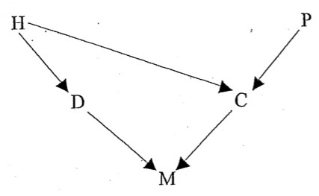
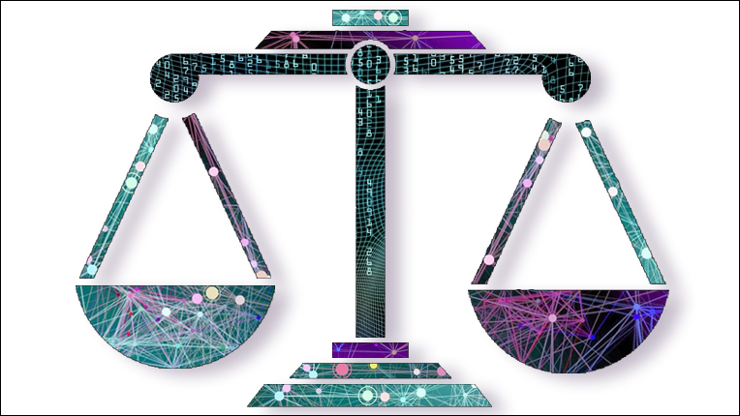
Against Predictive Invariance
Alexander Williams Tolbert
University of Pennsylvania,
altol25@upenn.edu

Slide 62
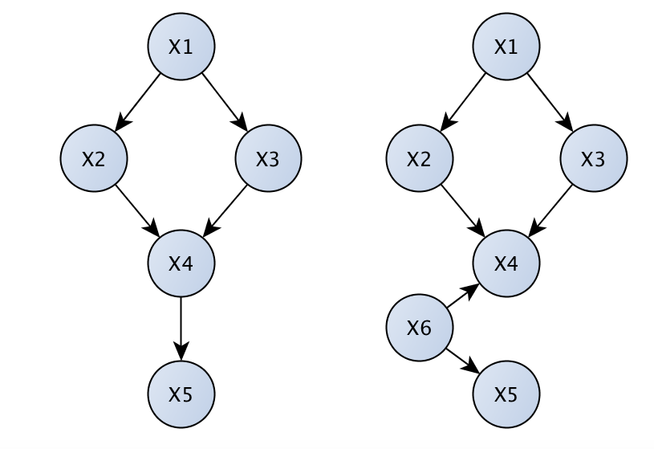
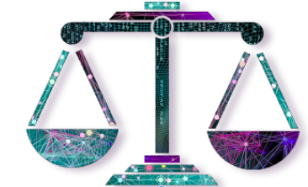
Morals and Methodology
We claim there can be no answer to the social justice critique until data science adopts a more causal orientation.

Slide 63
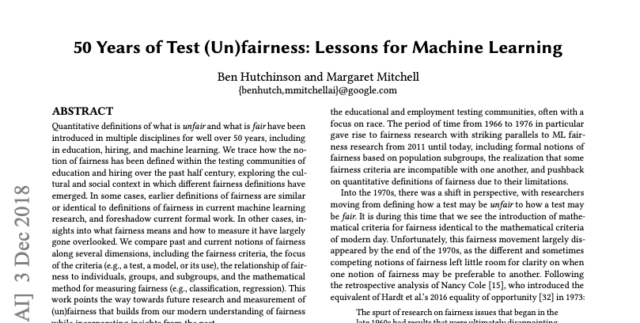
Fairness in Psychometrics
At first approximation: fairness notions limited to what you can express with S, R, O, L and conditional probability.

Slide 64
Fairness in Psychometrics
At first approximation: fairness notions limited to what you can express with S, R, O, L and conditional probability. Having one extra variable doesn’t solve all the problems, but it allows you to get closer to expressing genuine fairness concepts.

Slide 65
Predictive Invariance
Predictive invariance (PI) requires that individuals receiving the same score S have the same expected outcome O regardless of sensitive variable R. In the language of conditional independence: O ⊥ R | S.
Defendants with the same risk score have the same probability of re-arrest.
Students with the score on the entrance exam have the same expected GPA.
Applicants with the same credit score have the same probability of repayment.

Slide 66
Calibration within groups
Calibration within groups: For each possible risk score, the percentage of individuals assigned that risk score who are actually positive is the same for each group and is equal to the risk score. In probability notation: P(O = 1 | R = r, S = s) = P(O = 1 | R = r’, S = s) = s. Intuitively: not only is group membership not informative about outcome, once you know the score s, but the probability of the positive outcome is exactly the risk score.

Slide 67
Calibration implies Predictive Invariance
P(O=1 | S = s) = Σ_{r} P(O = 1 | R = r, S = s) P(R = r | S = s) (Total probability)
= s Σ_{r} P(R = r | S = s) (Calibration)
= s
= P(O = 1 | R = r’, S = s) (Calibration) Therefore: O ⊥ S | R.

Slide 68
Predictive Invariance: A Disciplinary Consensus?
Many discussions in the fairness literature suppose that predictive invariance is a necessary condition for fairness.

Slide 69
Predictive Invariance: Paramount Indicator
“Given that the raison d'etre for risk assessment instruments is to predict recidivism, the paramount indicator of test bias is predictive bias … On utilitarian grounds alone, any instrument used to inform sentencing must be shown to predict recidivism with similar accuracy across groups. If the instrument is unbiased, a given score will also have the same meaning regardless of group membership .... ” Skeem and Lowenkamp (2016) Risk, Race, & Recidivism: Predictive Bias and Disparate Impact

Slide 70
Predictive Invariance: Northpointe Responds
“Angwin et al. base their assessment of racial bias on an unrealistic criterion. ... The [ProPublica] authors ignore evidence of accuracy equity and predictive parity of the COMPAS risk scales.” “The risk scale exhibits predictive parity if the classifier obtains similar predictive values for two different groups such as blacks and whites, for example, the probability of recidivating, given a high risk score, is similar for blacks and whites.” Dieterich et al. (2016) COMPAS Risk Scales: Demonstrating Accuracy Equity and Predictive Parity

Slide 71
Calibration: Necessary for Fairness?
“I argue that among the statistical criteria of fairness discussed in the literature, none except perhaps calibration is a genuine necessary condition on fairness for predictive algorithms, on the grounds that all other such criteria can be violated by a manifestly fair and uniquely optimal predictive algorithm.”
Hedden (2021) On Statistical Criteria of Algorithmic Fairness

Slide 72
Against Predictive Invariance
Claim: considerations of fairness will typically require us not to satisfy predictive invariance.

Slide 73
Measurement Invariance
Measurement invariance (MI) requires that individuals with the same value of the latent L to have the same S regardless of sensitive variable R. In the language of conditional independence: S ⊥ R | L.
(Compare with predictive invariance, requiring: O ⊥ R | S.)

Slide 74
Measurement Invariance
Measurement invariance (MI) requires that individuals with the same value of the latent L to have the same S regardless of sensitive variable R. In the language of conditional independence: S ⊥ R | L.
Equally well-prepared (L) students will (in expectation) get the same SAT score.
Defendants posing the same danger receive (in expectation) same risk scores.
Applicants with the same probability of repayment receive the same credit score.

Slide 75
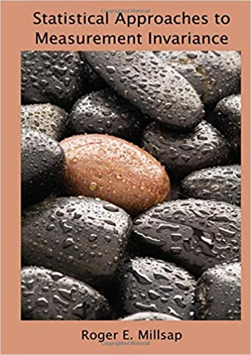
PI and MI: Why not Both?
In a series of papers, Millsap proves that predictive invariance and measurement invariance are typically incompatible. Scores satisfying one will typically not satisfy the other.
(1995) “Measurement Invariance, Predictive Invariance, and the Duality Paradox.” Multivariate Behavioral Research 30 (4): 577-605.
(1998) “Group Differences in Regression Intercepts: Implications for Factorial Invariance.” Multivariate Behavioral Research 33 (3): 403–24.
(2007). “Invariance in Measurement and Prediction Revisited.” Psychometrika 72(4): 461–73.
(2011) Millsap, Roger E.llis. Statistical Approaches to Measurement Invariance. Routledge.

Slide 76
PI and MI: Why not Both?
Measurement Invariance ⇒ Predictive Bias:
In a classist society, we would not expect equally academically “prepared” students to have equal GPAs (e.g. poorer students need many jobs).
If we require MI, equally prepared students must get equal SAT scores.
But then equal SAT scores cannot predict equal GPAs, so PI fails.

Slide 77
PI and MI: Why not Both?
Measurement Invariance ⇒ Predictive Bias:
In a racist society, we would not expect equally “dangerous” defendants to have equal chances of arrest (e.g. racial minorities face more police harassment).
If we require MI, equally dangerous defendants must get equal risk scores.
But then, equal risk scores cannot predict equal chances of arrest.

Slide 78
PI and MI: Why not Both?
Predictive Invariance and Measurement Invariance are compatible only if expected outcomes are direct expressions of latent “merit”.¹ In other words: only if society is already fair. Imposing prediction invariance when society is unfair is not likely to make society any more fair, but rather less. Predictive invariance requires punishing people (in the name of fairness!) for likely bad outcomes that reflect social disadvantage and not just latent “merit”. 1. By “merit” all we mean is the contextually relevant latent (unobserved) property of interest e.g. college preparedness or danger posed to the community.

Slide 79
Empiricism Gone Bad
The problem, I want to suggest, is a kind of cheap empiricism: there is a tendency in ML to frame everything as a prediction problem, even where it is not appropriate. Some problems require, not just predicting future observable outcomes, but judgements of latent merit/dessert.

Slide 80
Empiricism Gone Bad
“Our notion of individual fairness is very simple: it states that it is unfair to preferentially choose one individual (e.g. for a loan, a job, admission to college, etc.) over another if he or she is not as qualified as the other individual. ... in contextual learning, the quality of an arm is clear: its expected reward. We view different arms j as representing different populations (e.g. different ethnic groups, cultures, or other divisions within society), and view the context x^{t}_{j} at round t as representing information about a particular individual from that population. Each population has its own underlying function f_{j} which maps contexts to expected payoff. At each time step t, the algorithm is asked to choose between specific members of each population, represented by the contexts x_{j}. The quality of an individual is thus exactly E[r_{j}] = f_{j}(x_{j}). Our fairness condition translates thus: for any pair of arms j,j’ at time t, if f_{j} (x^{t}_{j} ) ≥ f_{j}′ (x^{t}_{j}′ ), then an algorithm is said to be discriminatory if it preferentially chooses the lower quality arm j.” Joseph, Matthew, Michael Kearns, Jamie Morgenstern, Seth Neel, and Aaron Roth. “Fair Algorithms for Infinite and Contextual Bandits.” ArXiv:1610.09559 [Cs], June 29, 2017. http://arxiv.org/abs/1610.09559.

Slide 81
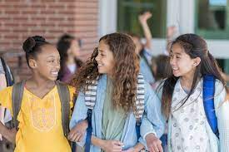
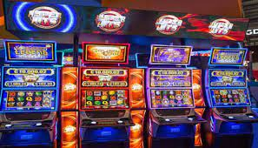
Empiricism Gone Bad
In ethically sensitive context, expected outcome does not perfectly track merit (or the relevant latent property). In other words: even if we had a crystal ball that could predict the future, the problem of treating people fairly would not be solved.
=

Slide 82
Measurement Invariance
Machine learners should try to solve measurement problems and not just prediction problems. To that end, existing work on fairly inferring latent properties ought to be instructive.
(1995) “Measurement Invariance, Predictive Invariance, and the Duality Paradox.” Multivariate Behavioral Research 30 (4): 577-605.
(1998) “Group Differences in Regression Intercepts: Implications for Factorial Invariance.” Multivariate Behavioral Research 33 (3): 403–24.
(2007). “Invariance in Measurement and Prediction Revisited.” Psychometrika 72(4): 461–73.
(2011) Millsap, Roger E.llis. Statistical Approaches to Measurement Invariance. Routledge.

Slide 83
Thank You!

